Slide 1

Handwritten
Digit Recognition

Slide 2

Team Members
Samiu Esika Upoma
2020-1-60-082
Israfil Arman
2020-1-60-086
Shafia Hasnin
2020-1-60-209
Md. Habibuzzaman
2020-1-60-212

Slide 3

Description
Handwritten digit classification is a well-known and important problem in the field of optical character recognition (OCR). The primary challenge is correctly classifying digits which are highly varied in their visual characteristics primarily due to the writing styles of different individuals.

Slide 4

Dataset Collection
Ekush
Bengali.ai
Keras
NumtaDB

Slide 5
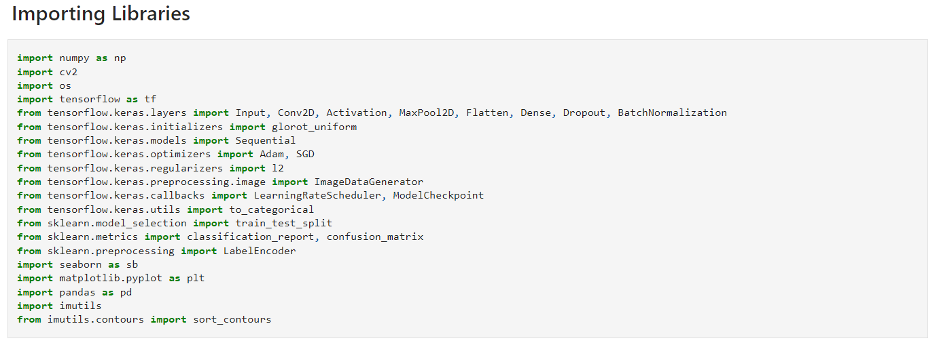

Slide 6
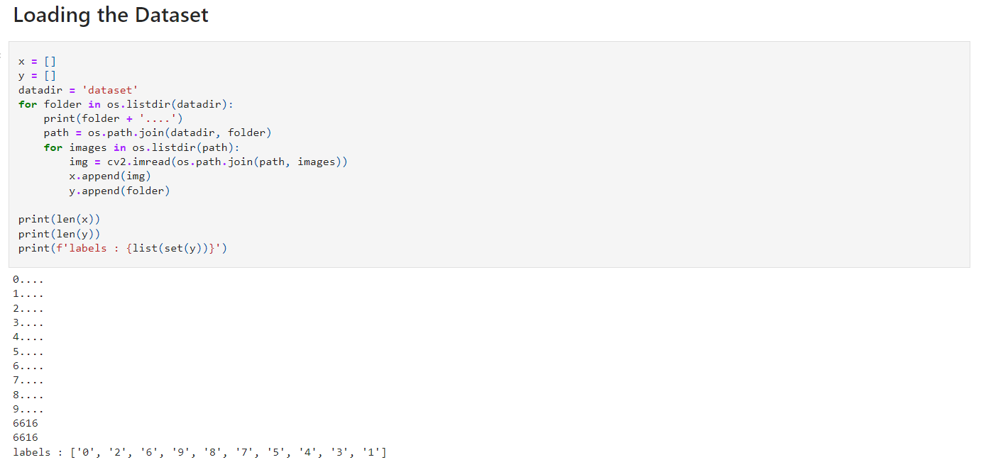

Slide 7
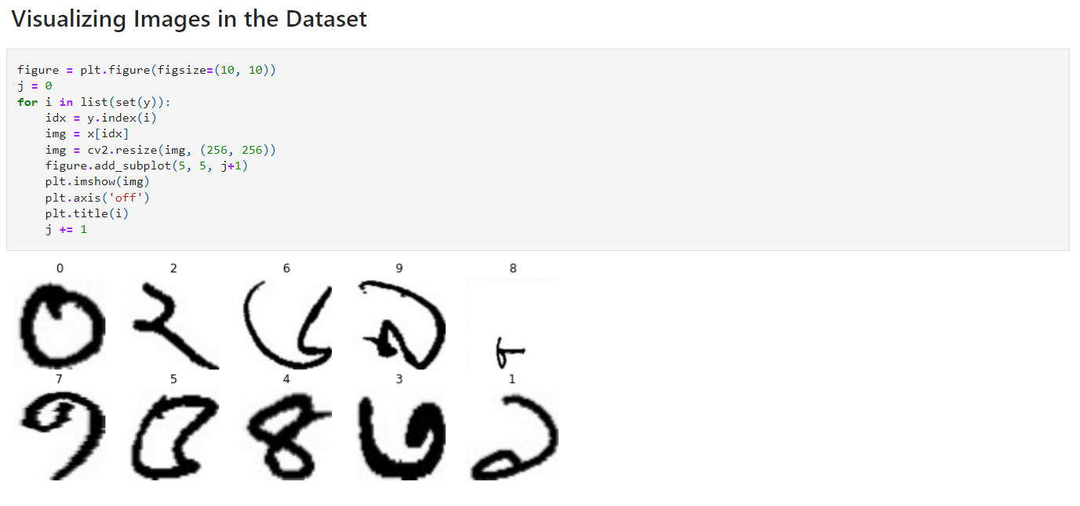

Slide 8
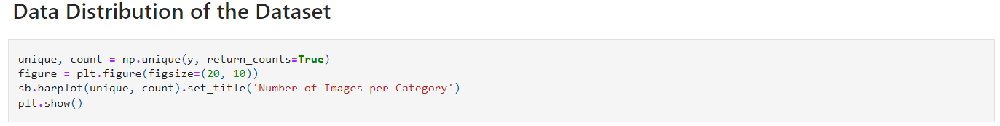
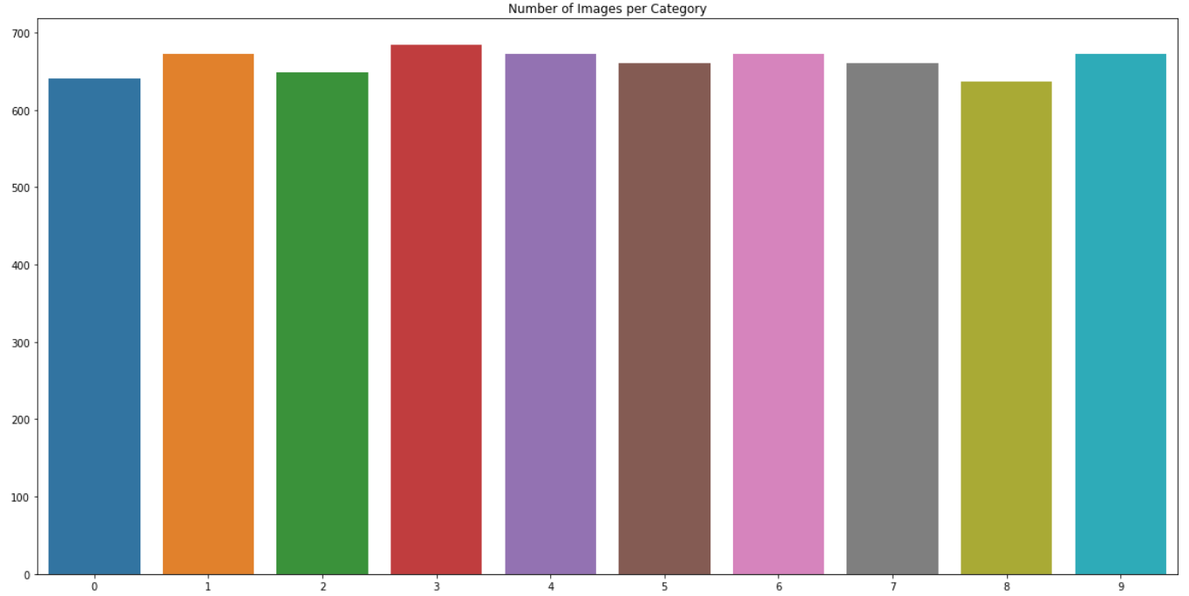

Slide 9
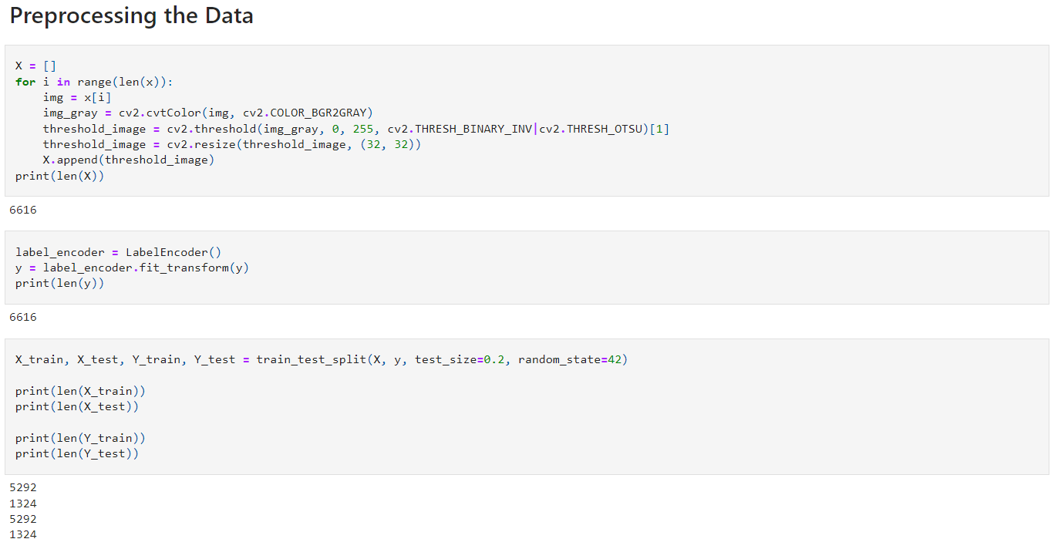

Slide 10
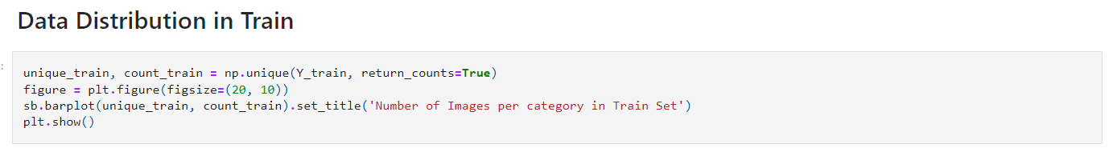
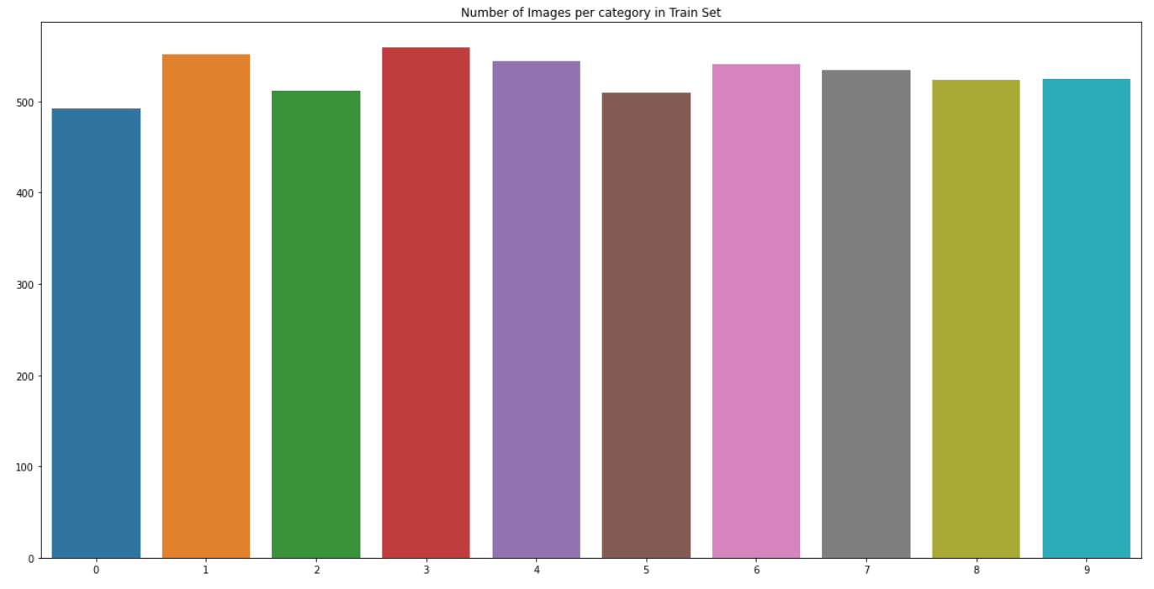

Slide 11
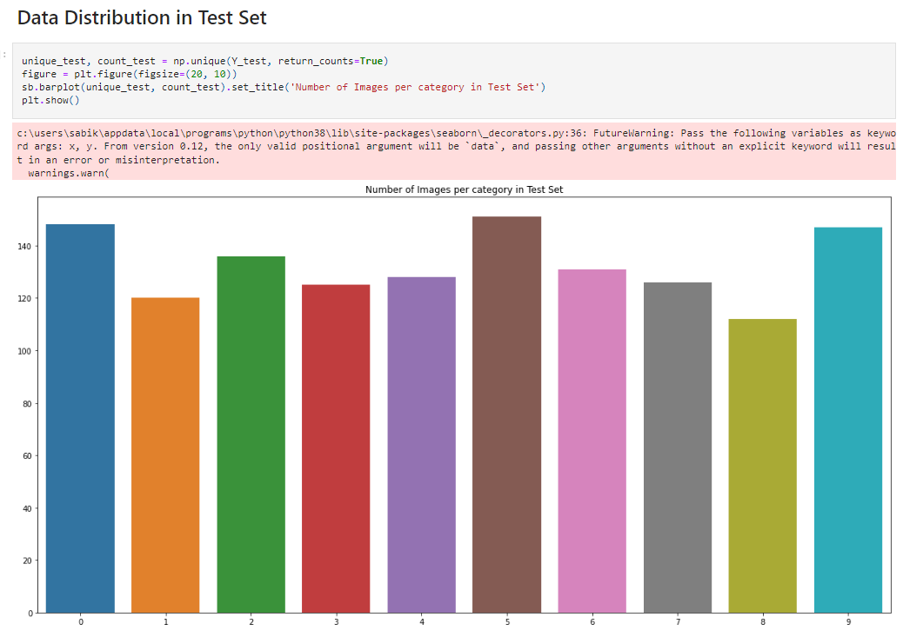

Slide 12
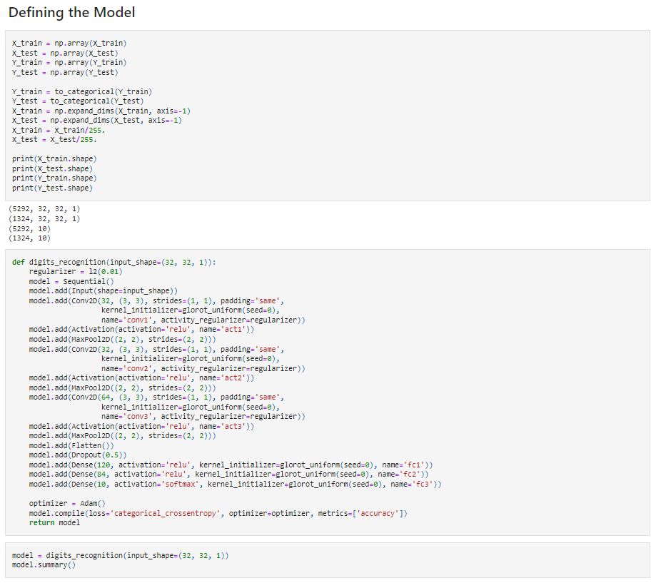
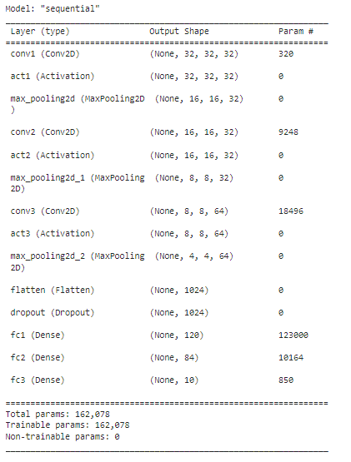

Slide 13
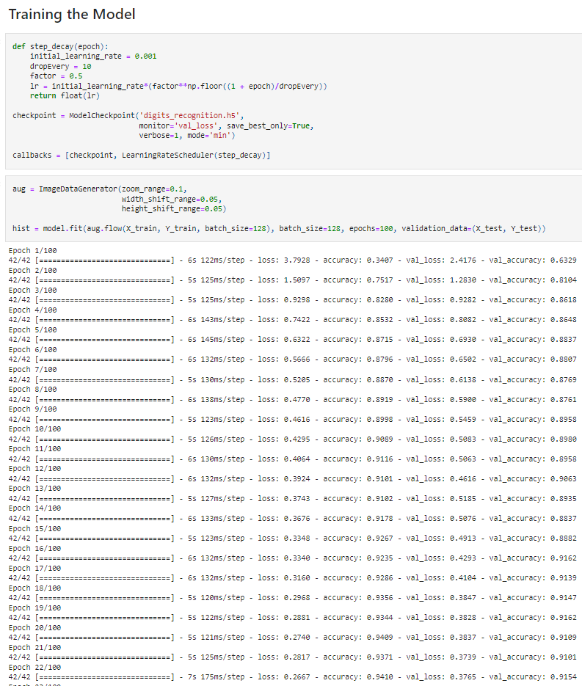
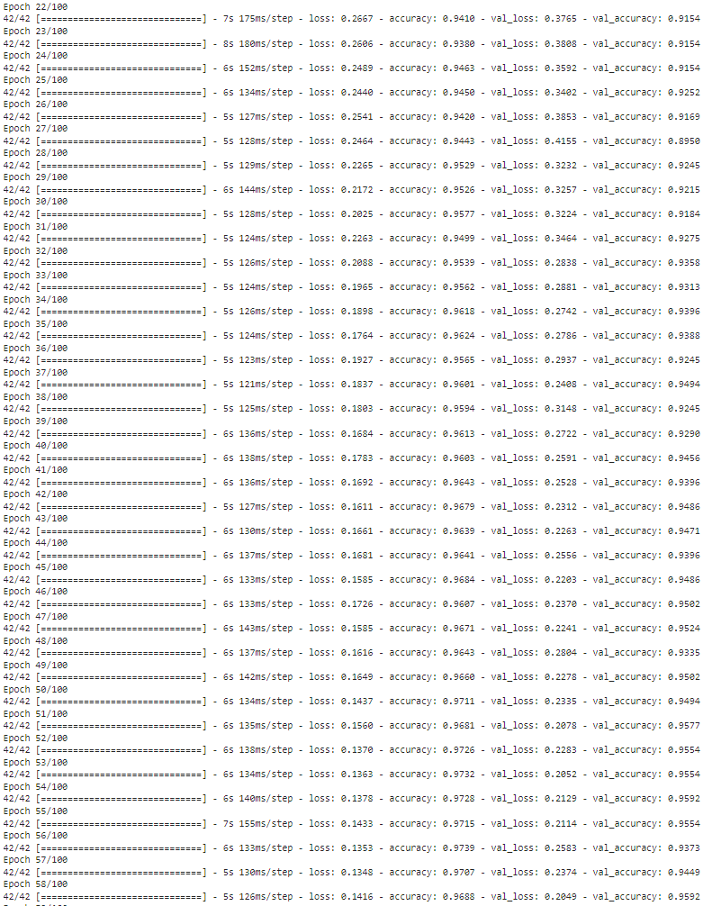

Slide 14
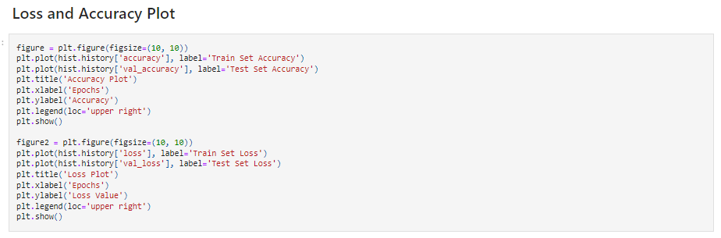
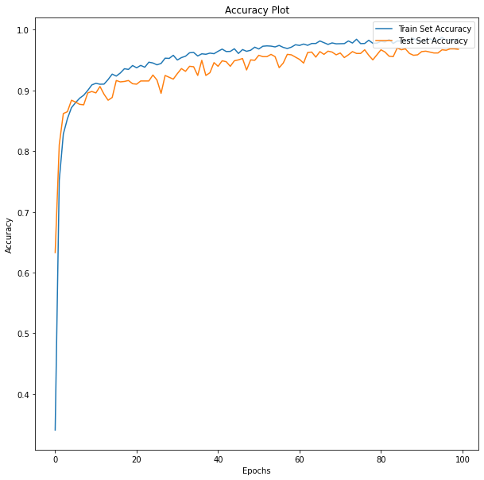
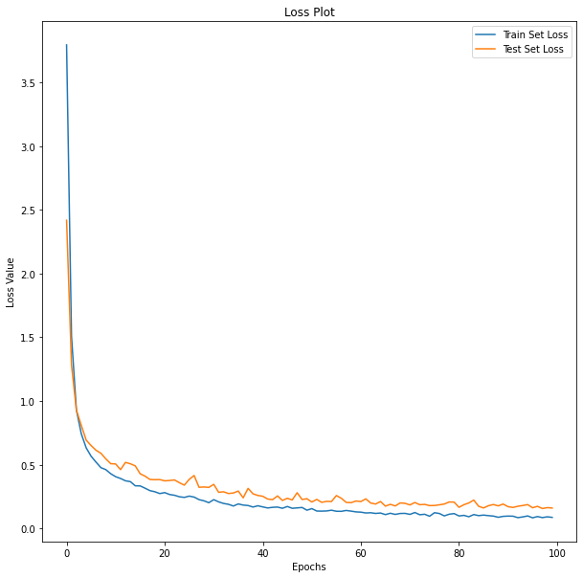

Slide 15
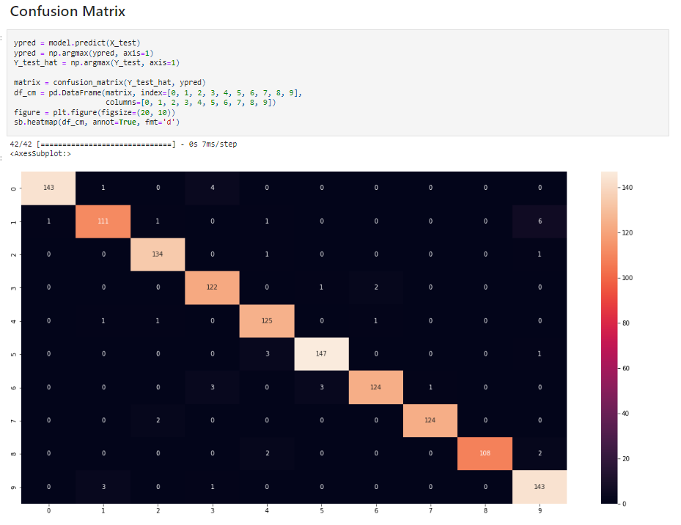

Slide 16
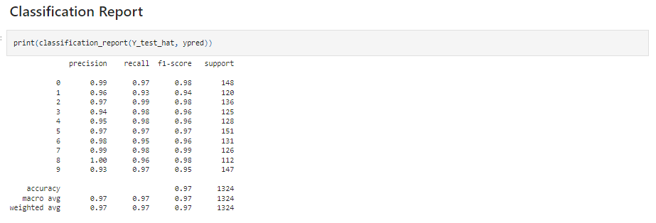

Slide 17
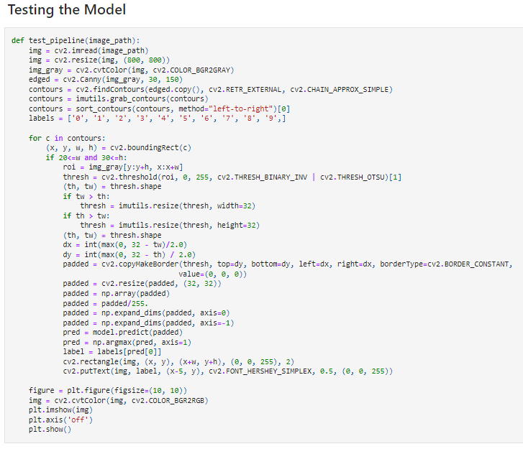
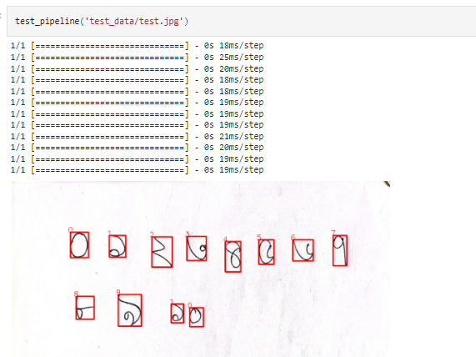

Slide 18


Thank You

